Slide 1
Business Process Engineering
Week # 6
FALL-2025

Slide 2
Introduction to Business Process Modelling Techniques
To achieve business’ outputs, staff completes a series of tasks that get passed from one person or department to the next until tangible results are achieved.
Business Process Modelling Techniques are used to:
  Spot tasks that are redundant and eliminate them
  Improve efficiency by looking for areas where work gets held up because of bottlenecks in the process
  Ensure that efficient processes are repeated in the same way every time, even when a new staffer must perform part of the process

Slide 3
Common Business Process Modelling Techniques
Business Process Modelling Notation (BPMN)
UML Diagrams
Flowcharts
Data Flow Diagrams
Gantt Charts
Program Evaluation and Review Techniques (PERT) Diagram
Functional Flow Block Diagrams
Integrated Definition for Function Modeling (IDEF)
Petri Nets and Colored Petri Nets (CPNs)

Slide 4
Business Process Modeling Notation (BPMN)
Global standard for process modelling and one of the most important components of successful Business–IT alignment
A flow chart method that models the steps of a planned business process from end to end
Visually depicts a detailed sequence of business activities and information flows needed to complete a process
Purpose is to model ways to improve efficiency, account for new circumstances or gain competitive advantage

Slide 5
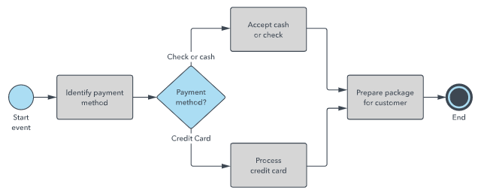

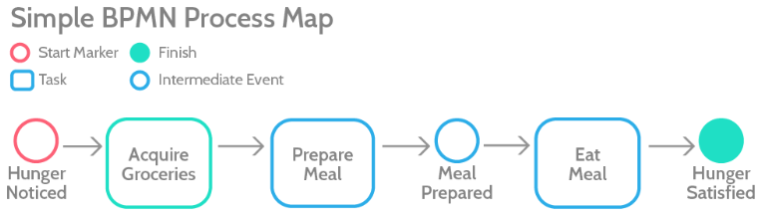

Slide 6
BPMN 2.0 Elements and Symbols
4 different elements or objects used for BPMN are:
Flows: events, activities, gateways
Connections: sequence flow, message flow, association
Swim lanes: pool or lane
Artifacts: data object, group, annotation

Slide 7
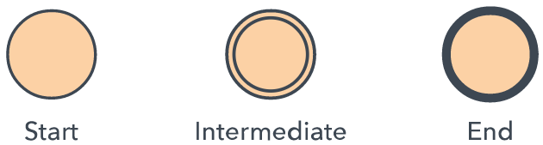
Events
A trigger that starts, modifies or completes a process
Event types include message, timer, error, compensation, signal, cancel, escalation, link and others
Shown by circles containing other symbols based on event type
Classified as either “throwing” or “catching”, depending on their function

Slide 8
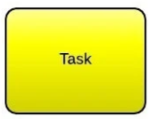
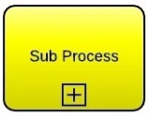
Activities
A task or activity carried out by either an individual or software
Activities are depicted as rectangles with rounded corners.
Compound activities are tasks that consist of several subprocesses.
Compound activities are depicted with a plus icon at the bottom of the rectangle

Slide 9
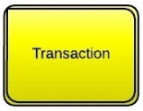
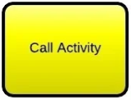
Activities
Transaction activities indicate activities in which every single step is so closely related that failing in one step would undo all the work contained within the compound activity.
Represented by rectangle with double border
Call activities are those activities in which a global task is used again.
The rectangle has a bold border

Slide 10
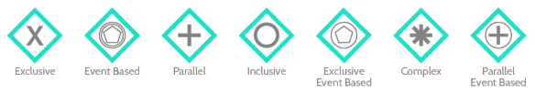
Gateways
Represent a split or convergence in the process chart
A conditional element and is represented by a diamond.
Exclusive gateways move workflows from one route to another. They indicate that there is only one option
Event-based gateways depend on something (other than the task) that happens

Slide 11
Gateways
Event-based gateways could represent that the continuation of the process depends on getting hold of more data, or waiting for a specific time, or meeting some other condition.
Parallel gateways are the ones in which two paths are side by side and don’t depend on an event. If a task isn’t dependent on another task, there’s no reason for them not to be done in parallel when the process begins
An inclusive gateway breaks the process into multiple branches, with an explanation of which condition must be met for the flow to continue down that branch

Slide 12
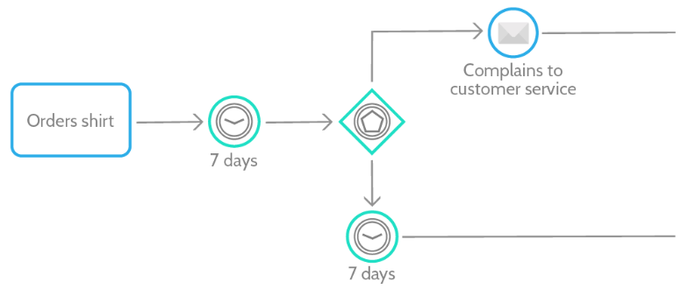
Event-based Gateway

Slide 13
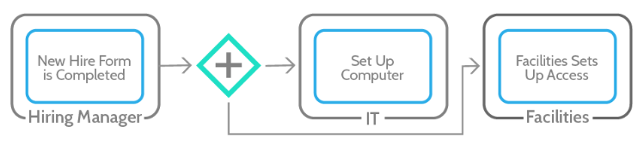
Parallel Gateway

Slide 14
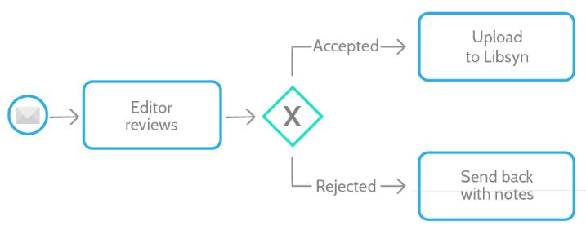
Exclusive Gateway

Slide 15
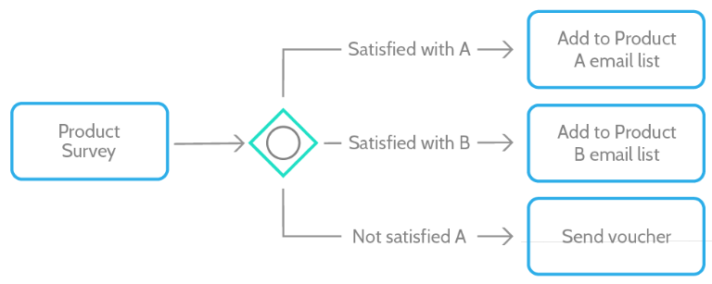
Inclusive Gateway

Slide 16
Inclusive Decisions (OR)
Take one or more branches after a decision activity
To know the value of OR
Company warehouse example
PTO
Model is using XOR and AND only

Slide 17
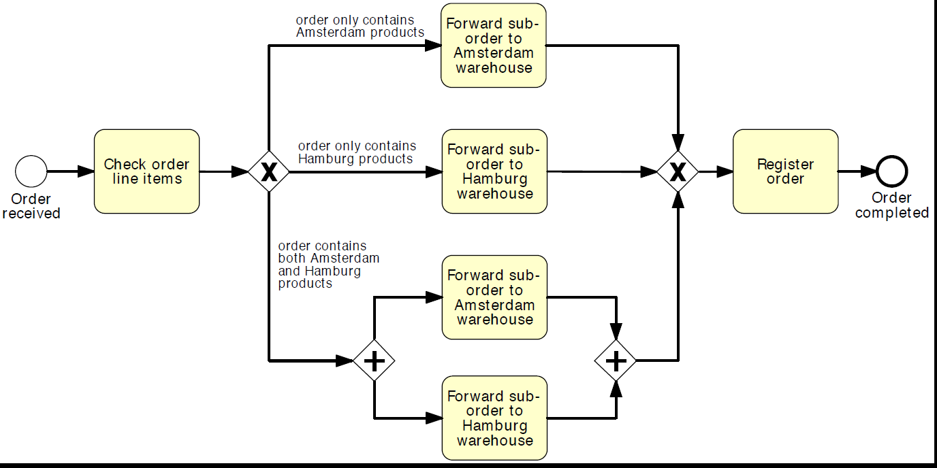
Example trial with XOR and AND
Scalability issue…

Slide 18
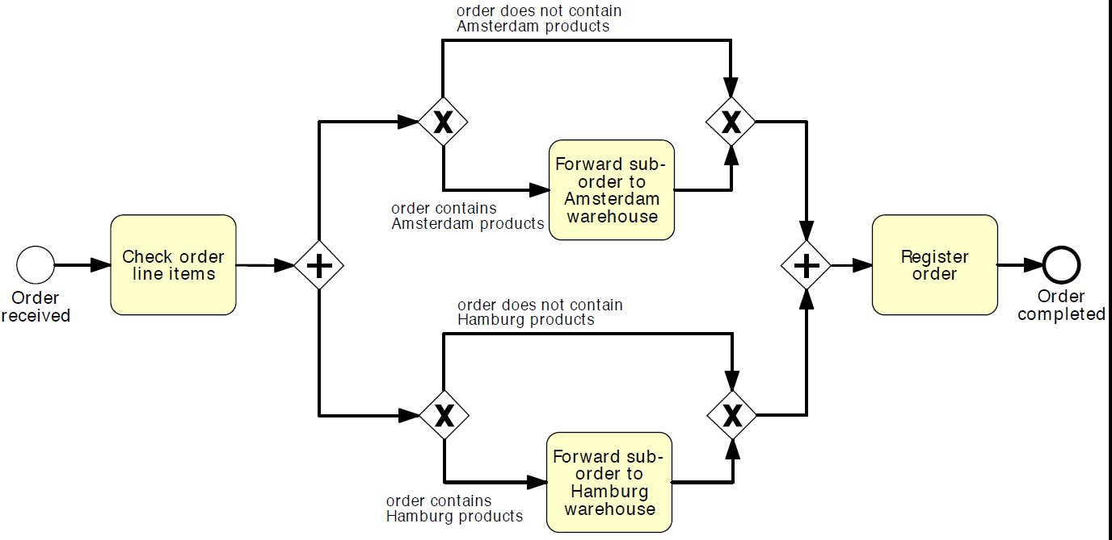
Example trial 2 with XOR and AND
The example handles three cases, Amsterdam only, Hamburg only, or
both warehouses. At the same time it allows an extra case i.e. empty order will also successfully register

Slide 19
OR Split
  An OR-split is similar to the XOR-split, but the conditions on its outgoing branches do not need to be mutually exclusive, i.e. more than one of them can be true at the same time.
  When we encounter an OR-split, we take one or more branches depending on which conditions are true
  Semantics, the OR-split takes the input token and generates a number of tokens equivalent to the number of output conditions that are true, where this number can be at least one and at most as the total number of outgoing branches.

Slide 20
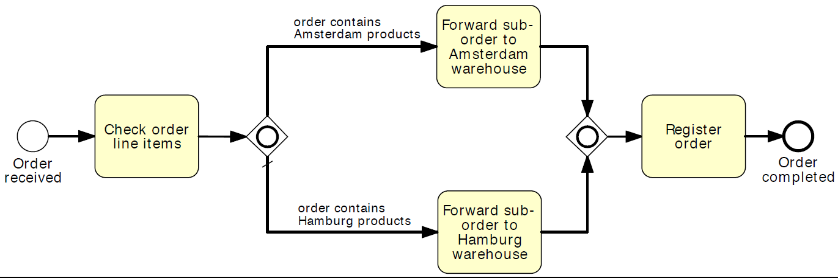
An example for modeling an inclusive decision with the OR gateway

Slide 21
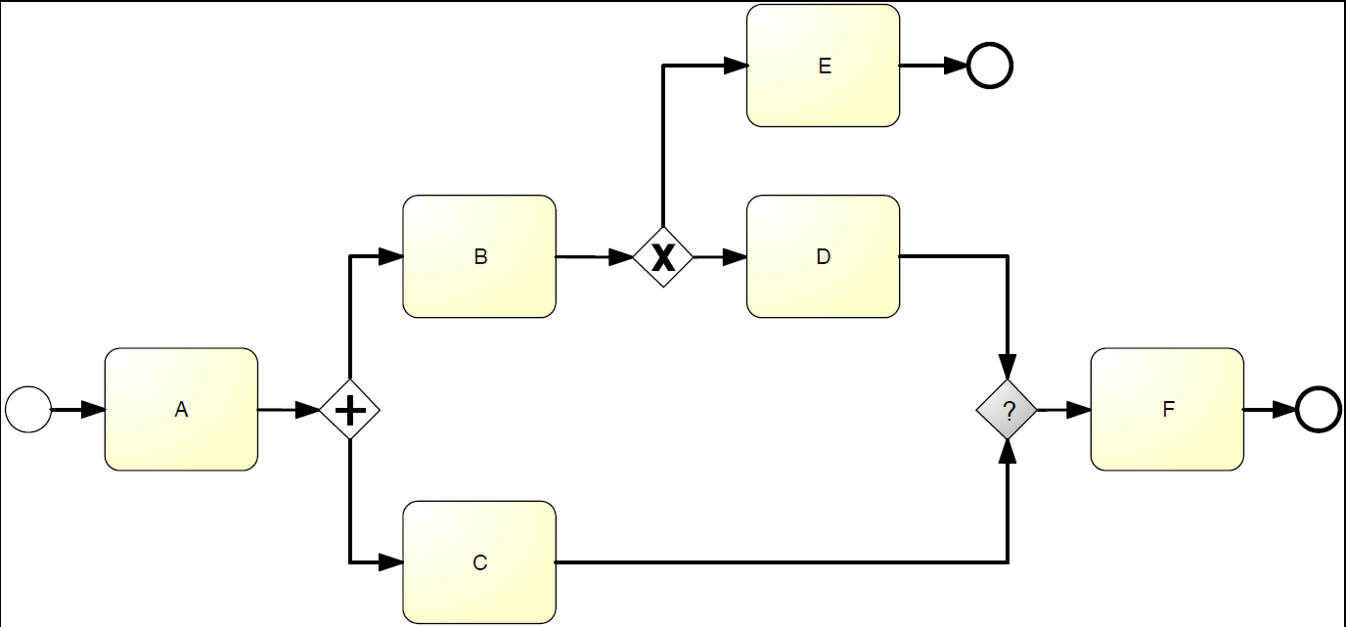
What type should the join gateway have such that instances of this process can complete correctly?

Slide 22
Try an AND-join to match the preceding AND-split
An AND-join waits for a token to arrive from each incoming branch.
While the token from the branch with activity “C” will always arrive, the token from the branch with activities “B” and “D” may not arrive if this is routed to “E” by the XOR-split.
So if activity “D” is not executed, the AND-join will wait indefinitely for that token, with the consequence that the process instance will not be able to progress any further
This is called DEADLOCK

Slide 23
Try an XOR-join
XOR-join works as a passthrough by forwarding to its output branch each token that arrives through one of its input branches.
We may execute activity “F” once or twice, depending whether the preceding XOR-split routes the token to “E” (“F” executed once)or to “D”(“F” executed twice)
Signal that the process has completed twice, since the end event following “F” will receive two tokens

Slide 24
Try OR-join
OR-join will wait for all incoming active branches to complete
If XOR-split routes control to “E”, the OR-join will not wait for a token from the branch bearing activity “D”, since this will never arrive
It will proceed once the token from activity “C” arrives
If the XOR-split routes control to “D”, the OR-join will wait for a token to also arrive from this branch
Once both tokens have arrived, it will merge them into one and send this token out, so that “F” can be executed once and the process can complete normally.

Slide 25
When should we use an OR-join?
OR-join semantics is not simple
Whenever we need to synchronize control from a preceding OR-split
AND-join should be used to synchronize control from a preceding AND-split and an XOR-join to merge a set of branches that are mutually exclusive

Slide 26
When should we use an OR-join?
Play the token game
Start with an XOR-join
Next try an AND-join
If both gateways lead to incorrect models use the OR-join

Slide 27
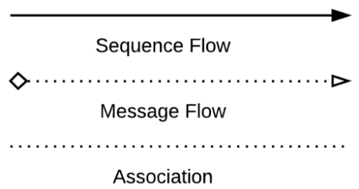
Connections
Sequence Flow: Used to show the order that Activities will be performed in a Process
Message Flow: Used to show the flow of Messages between two participants of a Process. Show lines of communication
Association: associates an artifact or text to an event, activity or gateway

Slide 28
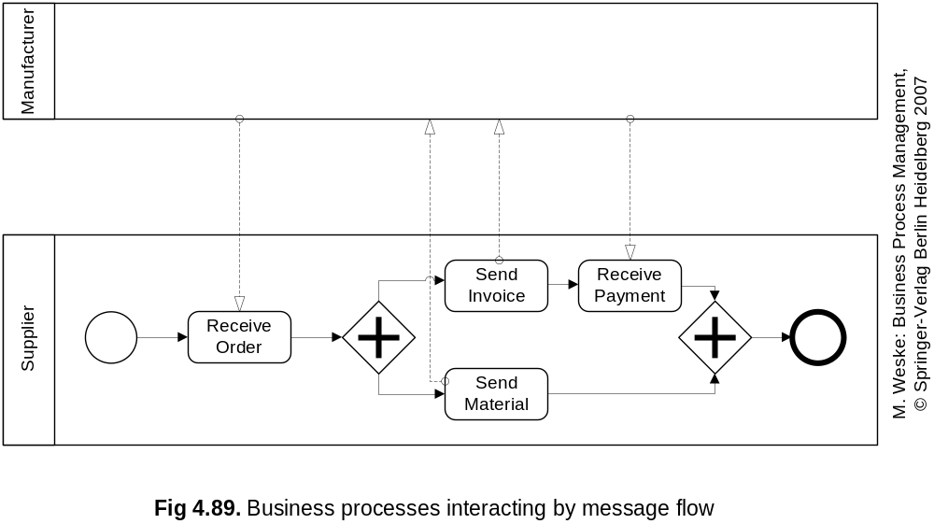
Interacting Processes
Sequence flow is allowed only between nodes in a single pool
  Communication occurs through message flows

Slide 29
Artifacts
Show that there is information that must be referenced outside of the BPMN diagram
A document icon shows that the data is needed or data is about to be produced
Rounded edge rectangle with a dotted border shows that activities form a group
Annotations revert to regular text to explain certain elements

Slide 30
Swim Lanes
Different departments and even different organizations need to work together to achieve something.
The pool consists of the functions or organizations who participate, and each of these has their own swim lane. Inside each lane, there are flows, objects, and artifacts
Pools represent different organizations or entirely separate processes
Lanes represent different teams or individuals within the same organization

Slide 31
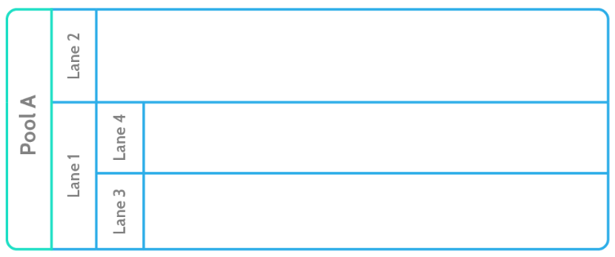
Swim Lane – Pool and Lane

Slide 32
Lanes
Often, processes need two or more departments to interact with each other. For example, a simple order fulfillment process might look like this:
Customer places order over the telephone with credit card
Order clerk charges credit card
Clerk notes down SKU and customer details
Clerk emails SKU and details to the warehouse
Item is packaged up with label
Shipping mail it to the customer
Or, in BPMN:

Slide 33
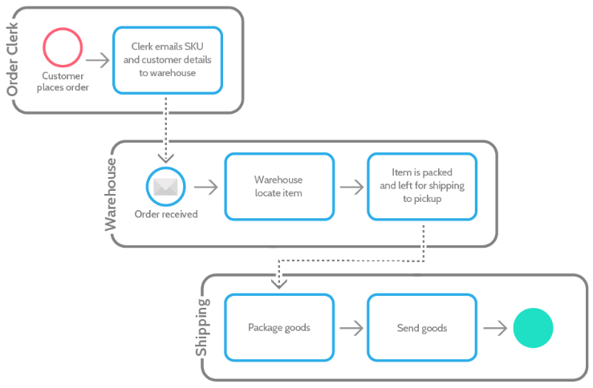

Slide 34
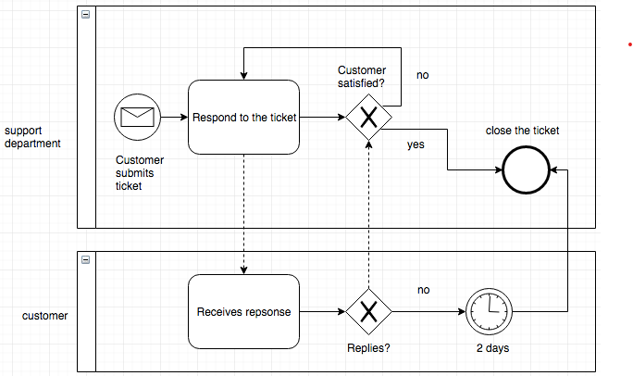
Example of a Process Map
To explain, above we have two pools with one lane each. The process is started by the customer, who sends a ticket to your company’s support team. Support responds, and then waits two days. If the customer hasn’t replied, the ticket is closed. If the customer is satisfied, the ticket is closed. Otherwise, communication continues until one of those conditions is met

Slide 35
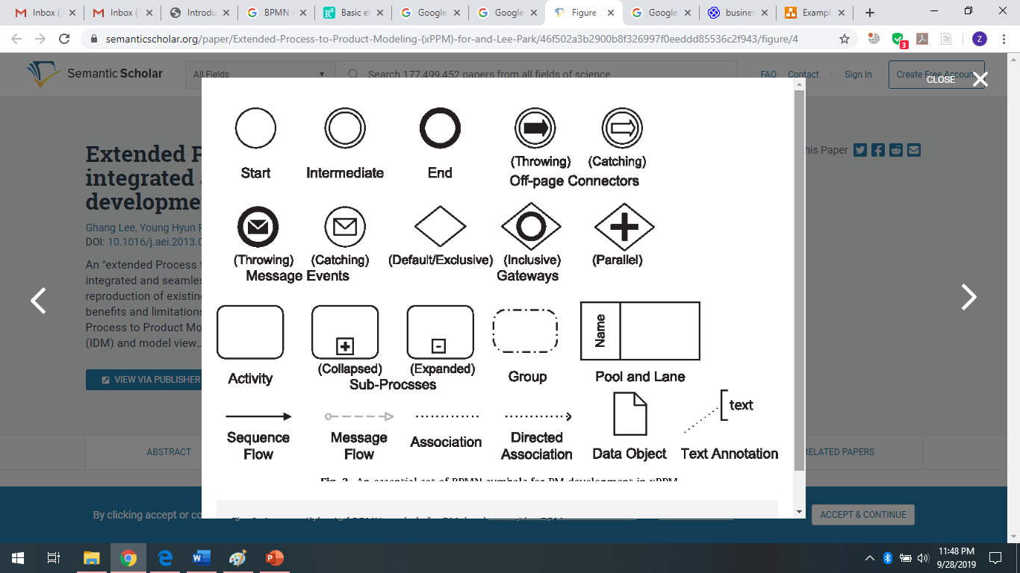
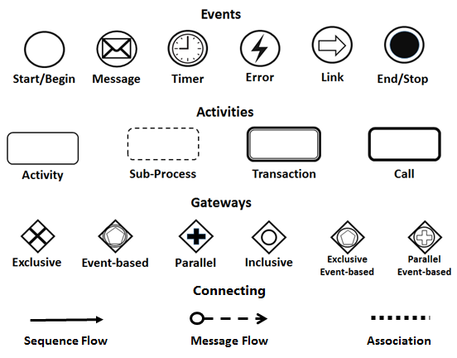
Notations

